Slide 1

Treatment of Acute Ischemic Stroke in Taiwan
Chin-I Chen M.D.
Director, Stroke Center, Taipei Medical University Wanfang Hospital
Director, Long term Care Committee, Taiwan Stroke Society

Slide 2
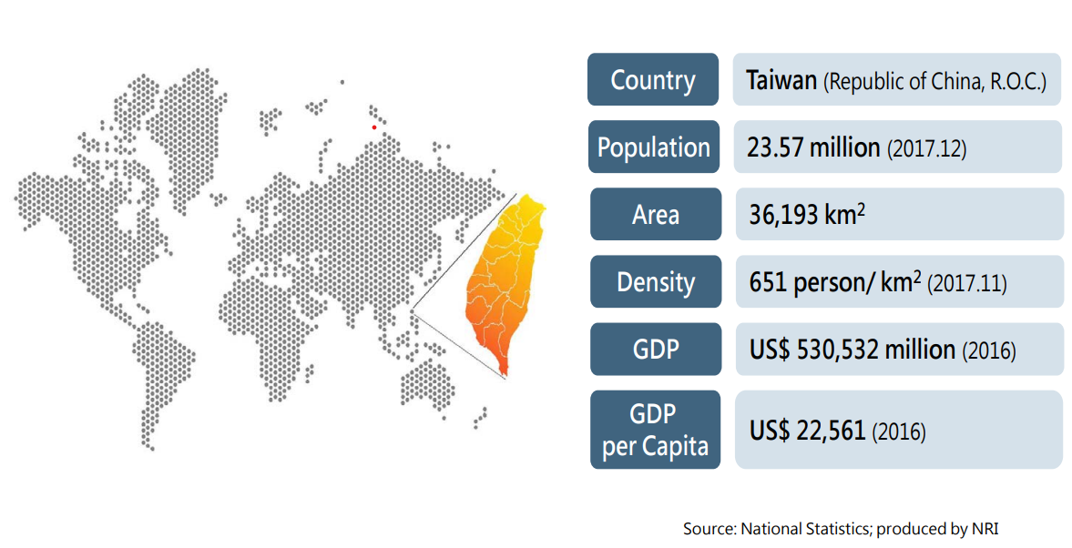
Notes:
Taiwan is a small island located in East Asia. Our land area is one-fifth that of Somaliland, yet our population is five times larger. Our GDP was around 35000 USD last year.

Slide 3
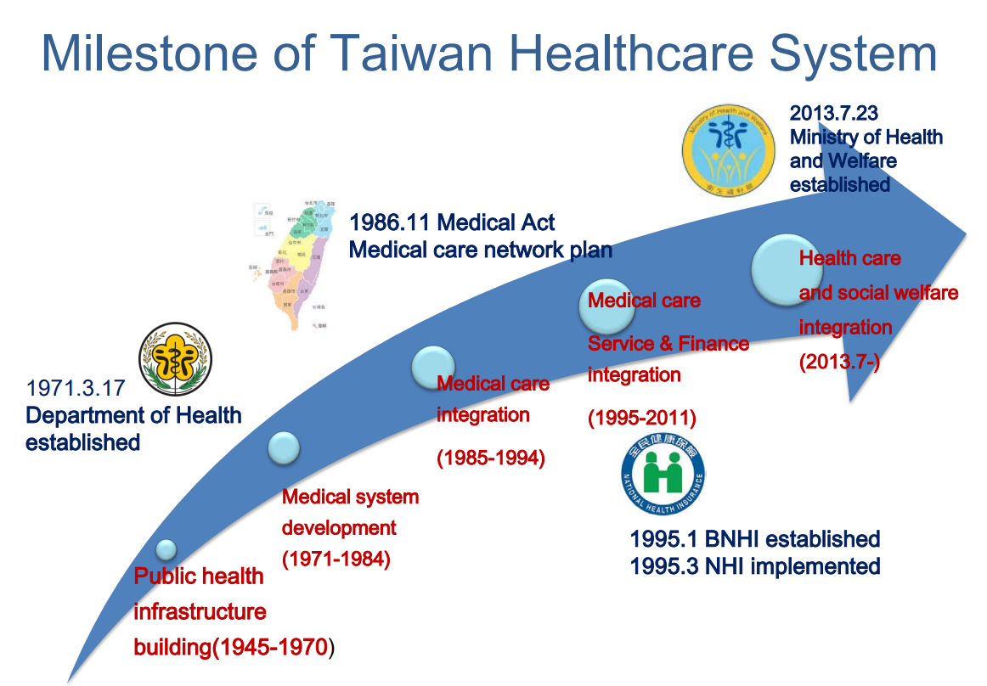
Notes:
Since 1995, Taiwan's national health insurance system provides coverage to an impressive more 99% of the population.

Slide 4
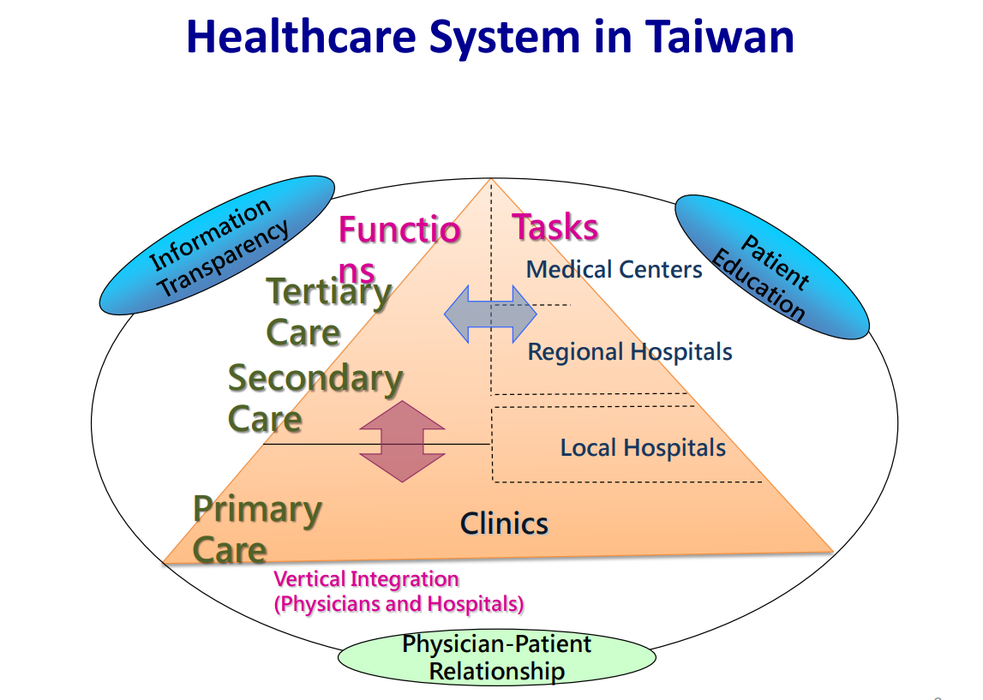
Notes:
The healthcare system in Taiwan consists of four tiers of institutions: clinics, local hospitals, regional hospitals, and medical centers. TMU Wanfang Hospital is one of the nineteen medical centers.

Slide 5
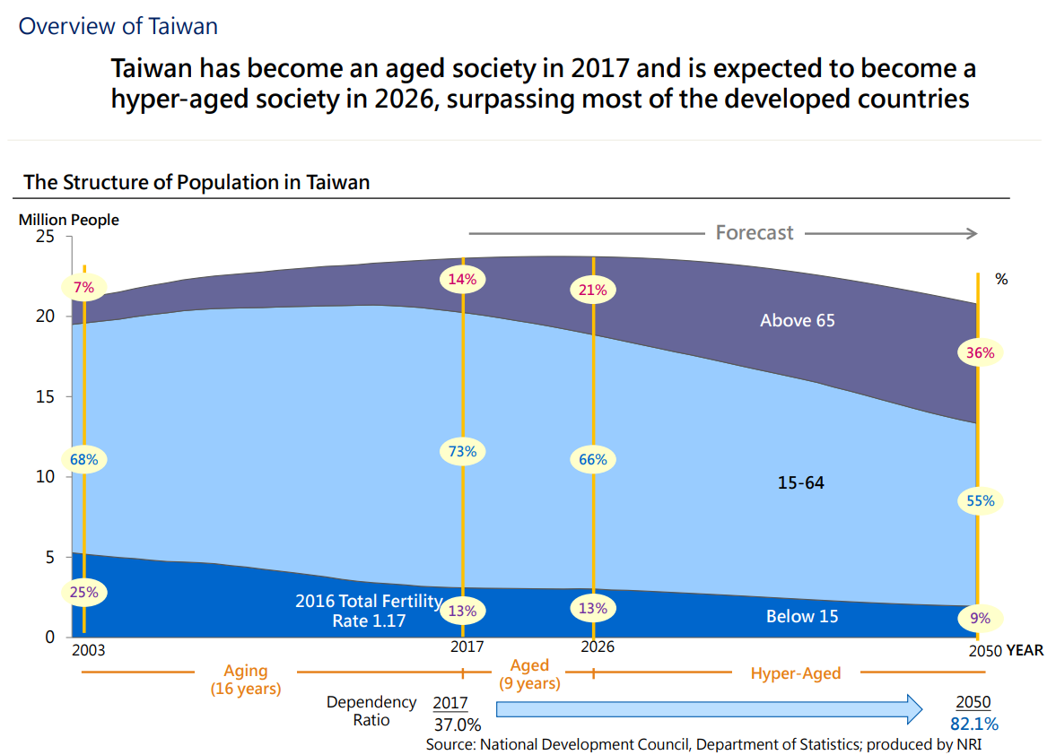

Slide 6
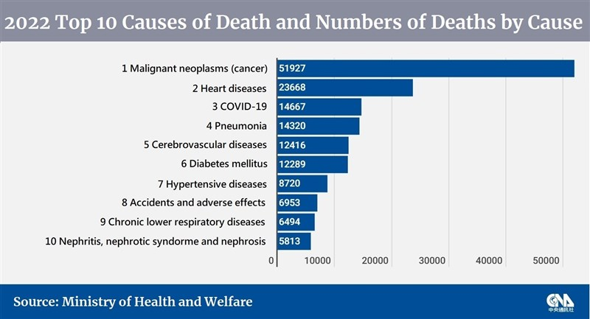
Notes:
As the population ages, the number of stroke patients tends to increase.
Cerebrovascular disease has emerged as the fifth leading cause of death among the top ten.

Slide 7
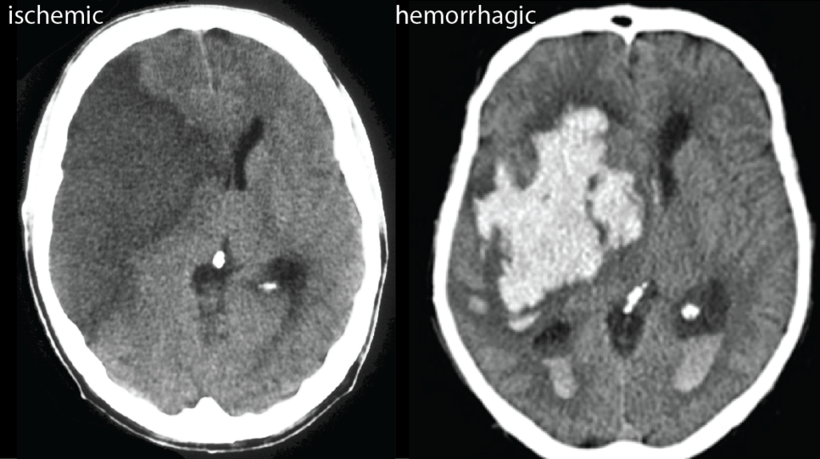
Notes:
Two types of stroke exist: ischemic stroke and hemorrhagic stroke.

Slide 8
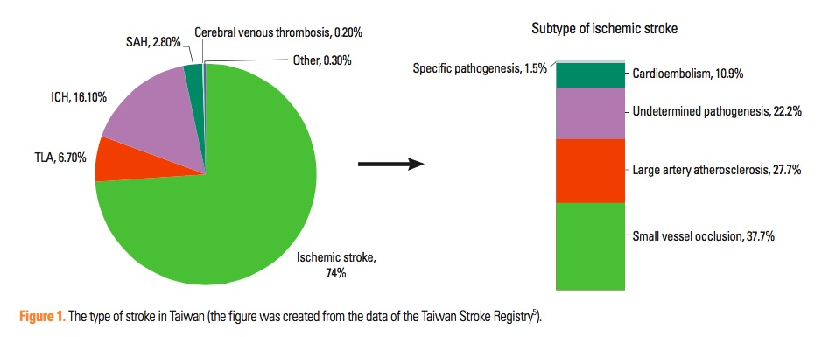
Journal of Stroke 2014;16(2):59-64
Notes:
From Taiwan Stroke Registration study. Ischemic strokes account for 74% of stroke patients, while hemorrhagic strokes make up 20% of cases.

Slide 9
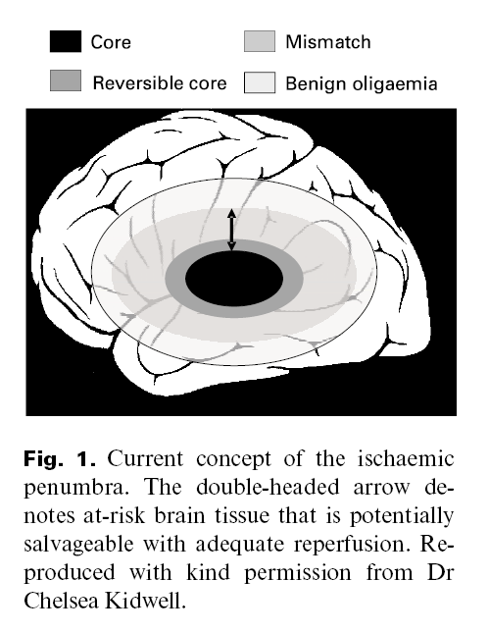
Time is Brain !
Penumbra
Intra-venous tPA: 4.5 hrs
Endovascular Thromectomy (EVT): 8 - 24 hrs
Notes:
The stroke penumbra refers to the area of brain tissue surrounding the core of the stroke where blood flow is compromised but not completely blocked. Prompt medical interventions aimed to restore blood flow to the penumbra and improve patient outcomes.

Slide 10
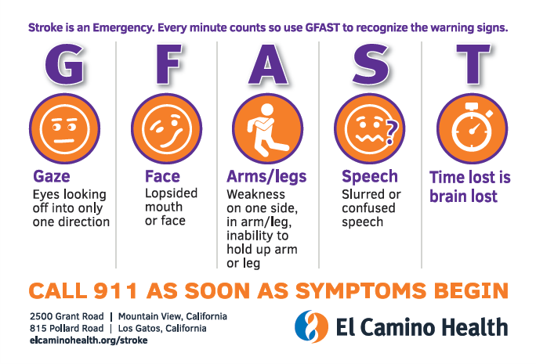
Notes:
We provide training to Emergency Medical Technicians (EMTs) on using GFAST to identify stroke warning signs.

Slide 11
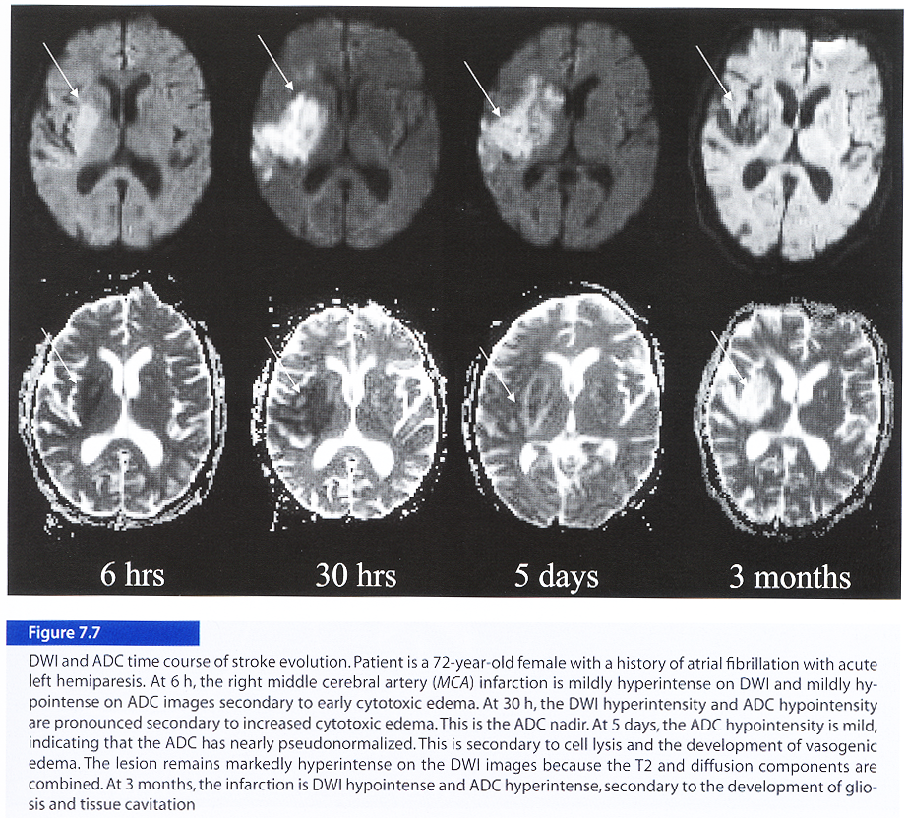
DWI
ADC
Notes:
Usually, we use CT for acute stroke patients because it’s faster and cheaper. Sometimes we also use diffusion-weighted imaging (DWI) and ADC in MRI to distinguish between new and old stroke lesions.

Slide 12
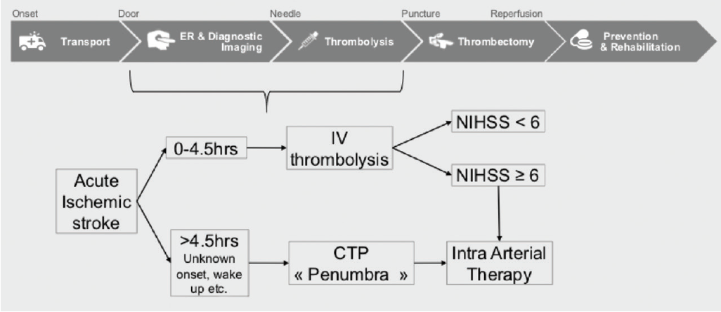
Endovascular Today, FEBRUARY 2018

Slide 13
DEFUSE III ＆ DAWN clinical trial

Slide 14
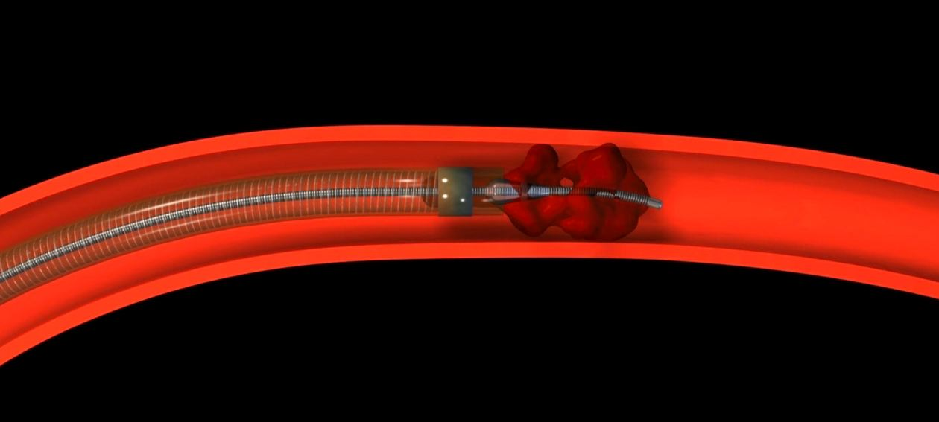
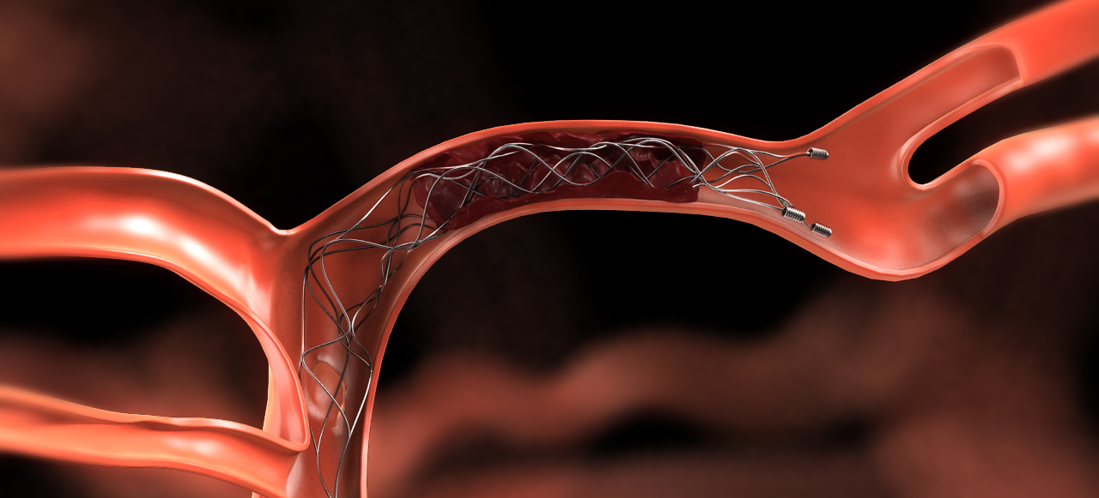
EVT Device
Penumbra System (Class IIa，Level of Evidence B-R)。
Stent Retriever (Class I，Level of Evidence A)。

Slide 15


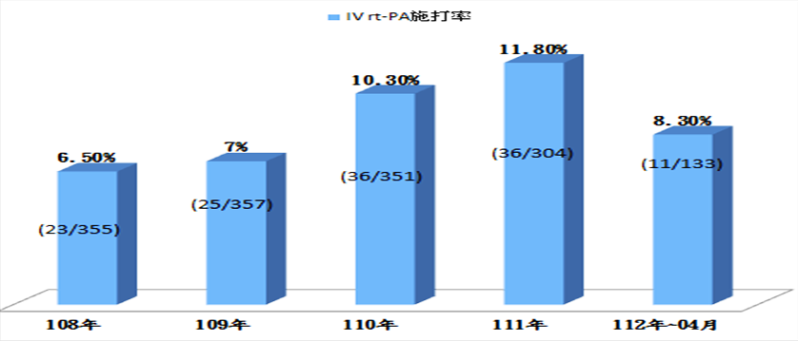



Intravenous TPA rate in Wanfang Hospital in the past 5 years

Slide 16
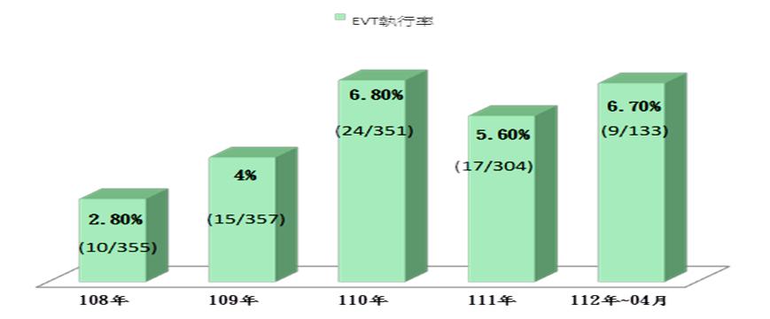
Endo-arterectomy rate in Wanfang Hospital in the past 5 years

Slide 17
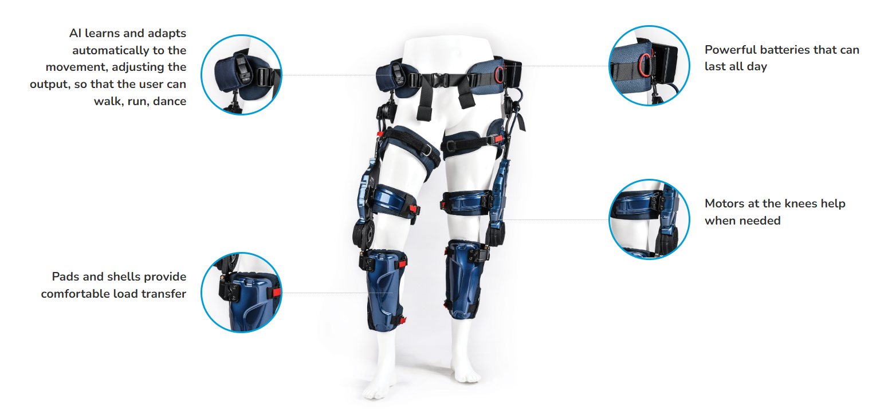
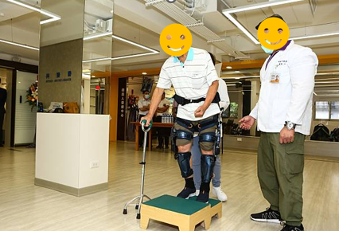
Wistron Exoskeleton
KEEOGO
Notes:
This Wistron exoskeleton is a wearable robotic device to assist stroke patients regain mobility and functionality in their limbs.

Slide 18
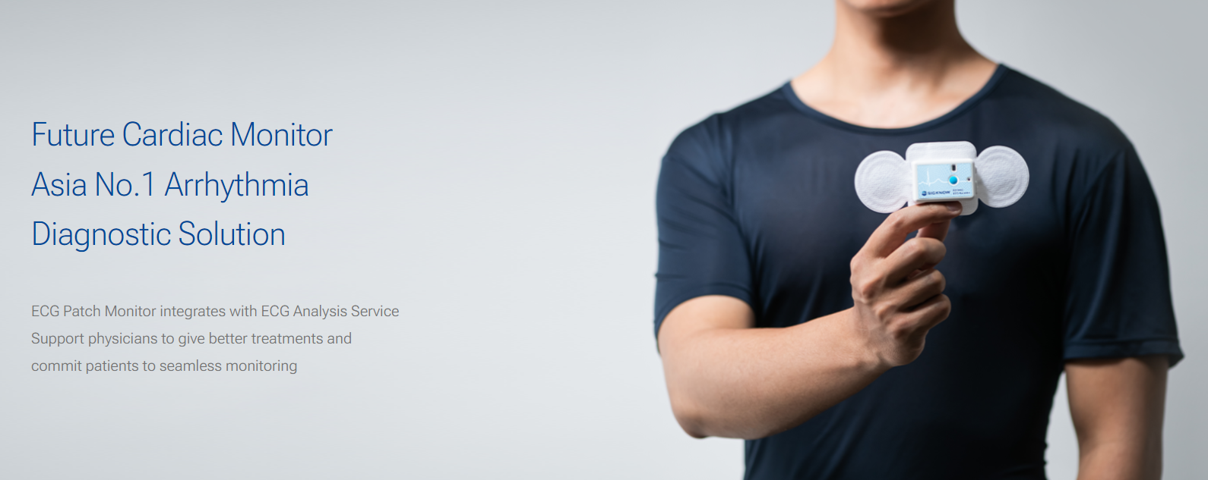
EZPRO Clinical Trial for Embolic stroke of undetermined source (ESUS) detection

Slide 19


Thank You for Listening

